Slide 1

2022-2023 Team Kickoff

Slide 2
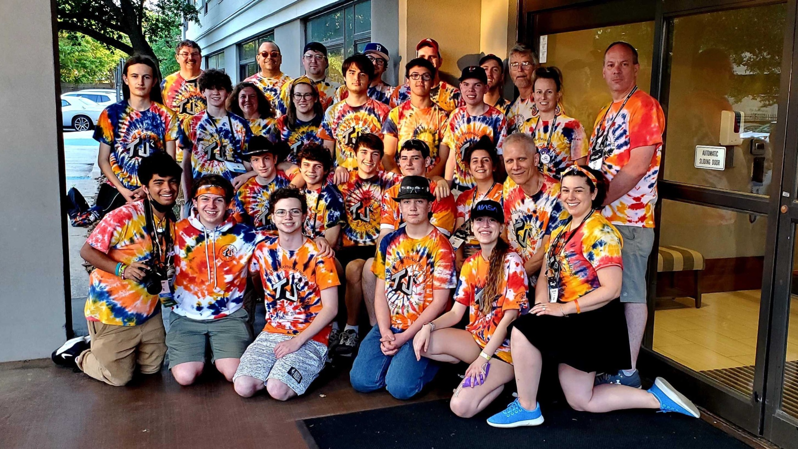
WELCOME!!!
28 years of tie dye!
Welcome to TJ2!
A team with bright
colors and even brighter personalities.
While we bring you through this presentation we hope you learn more about our team and values.
Enjoy!
2021-2022 World Championships

Slide 3
FIRST
FIRST - For Inspiration and Recognition of Science and Technology
TJ² - Trojan Johnson & Johnson
We are part of the NE FIRST District
We compete in NE FIRST District Events, District Championship, FRC World Championship, post season team events
For more information www.firstinspires.org

Slide 4
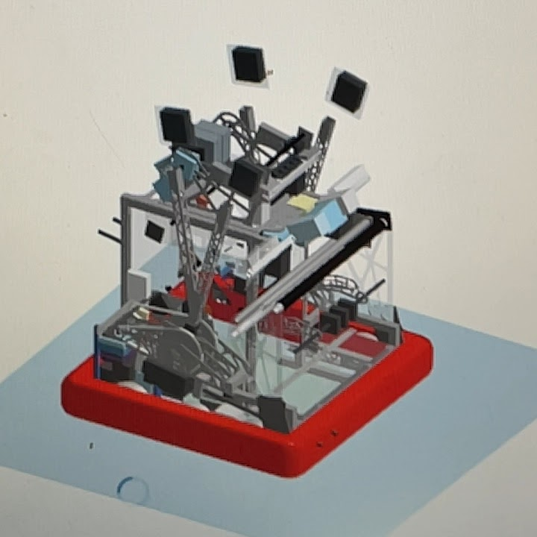
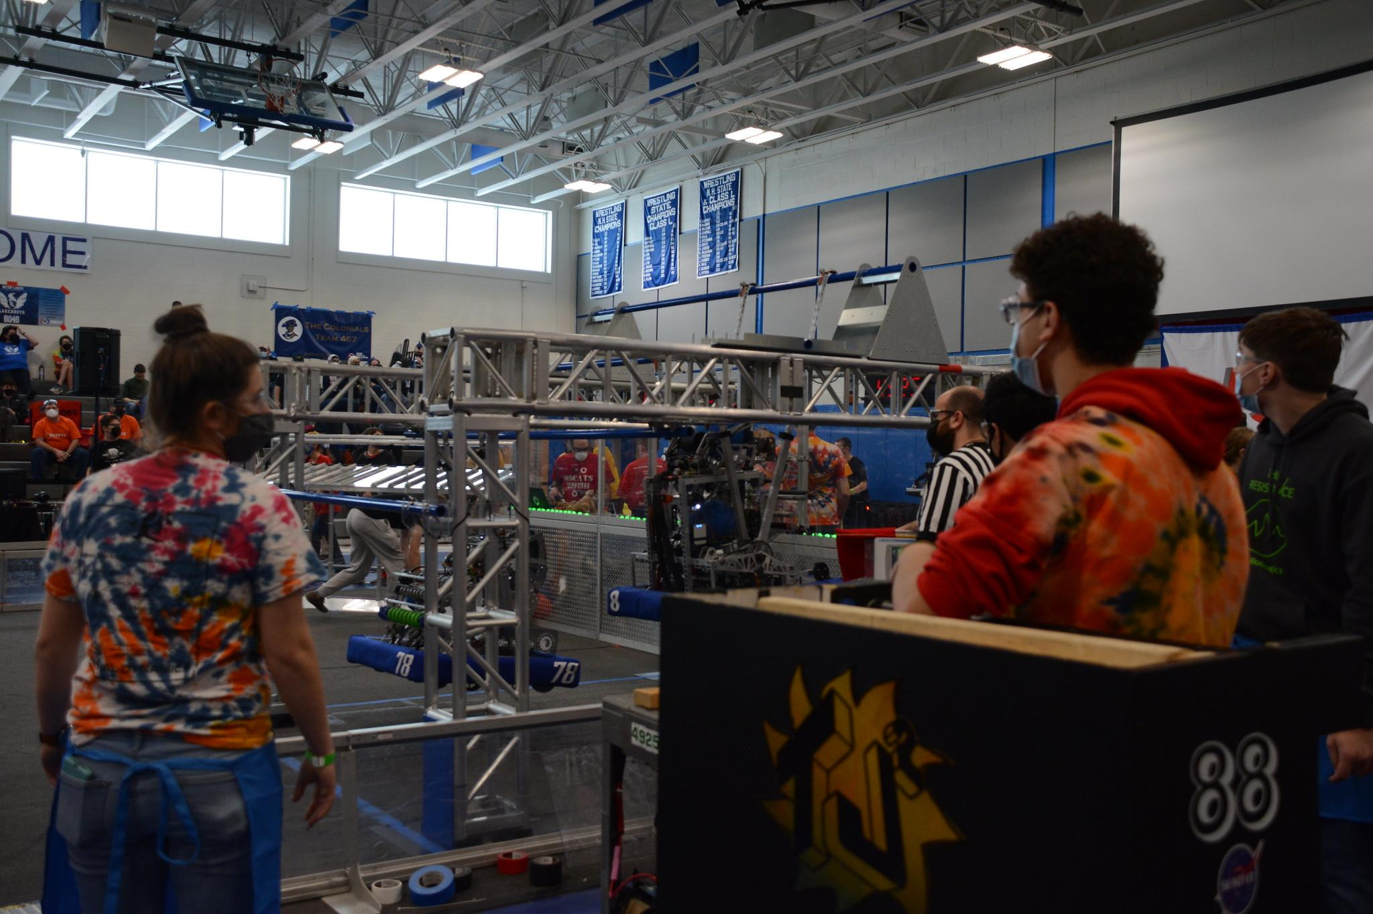
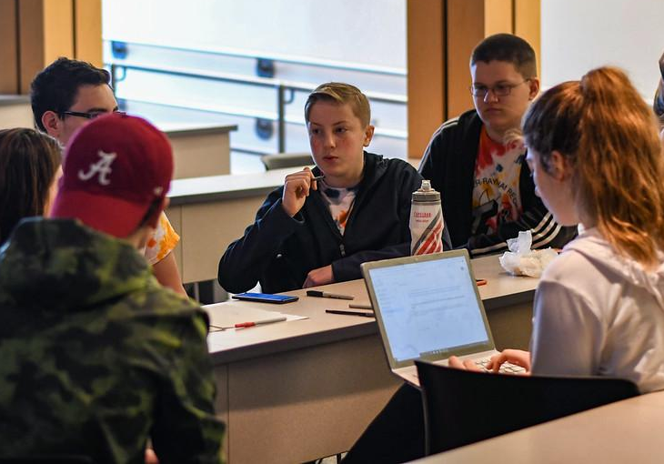
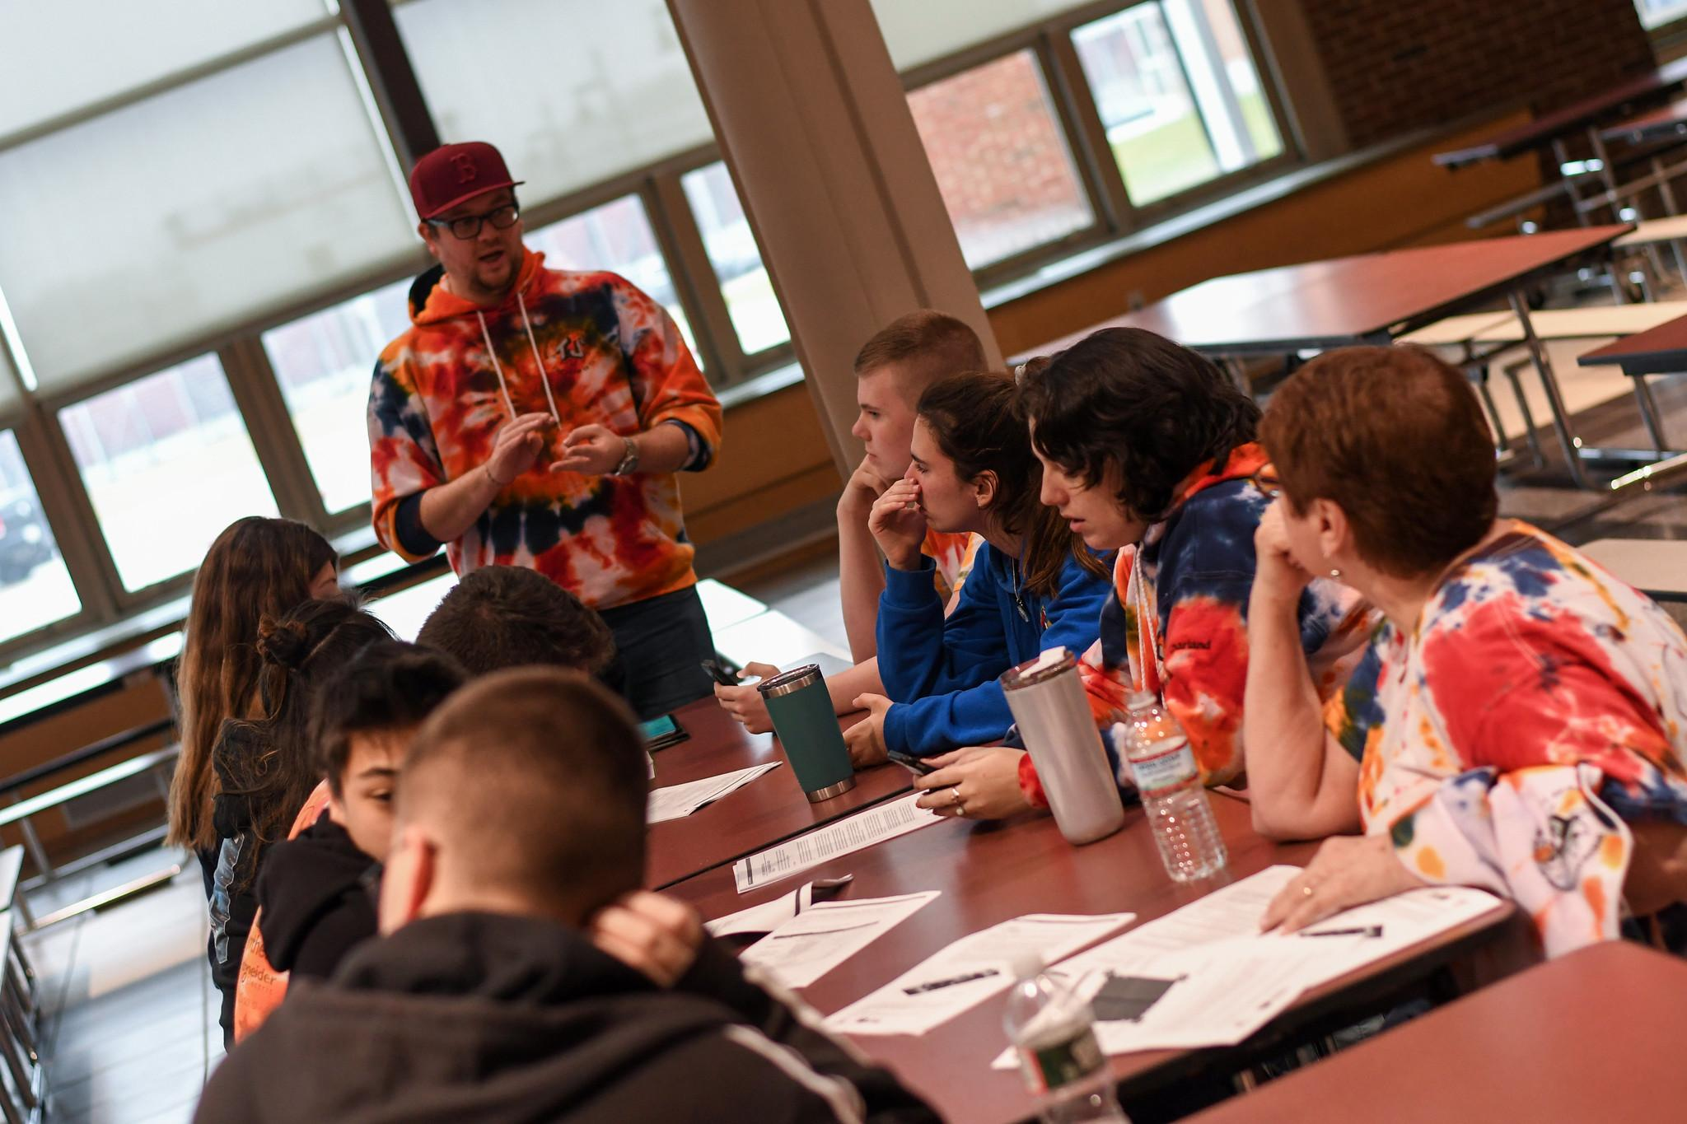
OUR TEAM GROUPS!
Throughout the years and build seasons we try to create different groupings to help members find a path on our team! No matter what someone's strengths or weaknesses are, you're able to discover these different groups on your own.
Below are some of the groups we currently have:
PR
BUILD
Strategy
ART
PROGRAMMING
CAD
Business oriented group / works with community engagement
Designing and creating the current seasons robot
Playing strategic moves on alliances and recording data
Creating Tie Dye pieces for our team!
Coding/software for the robot
Creating computer designs for the parts of the robot

Slide 5
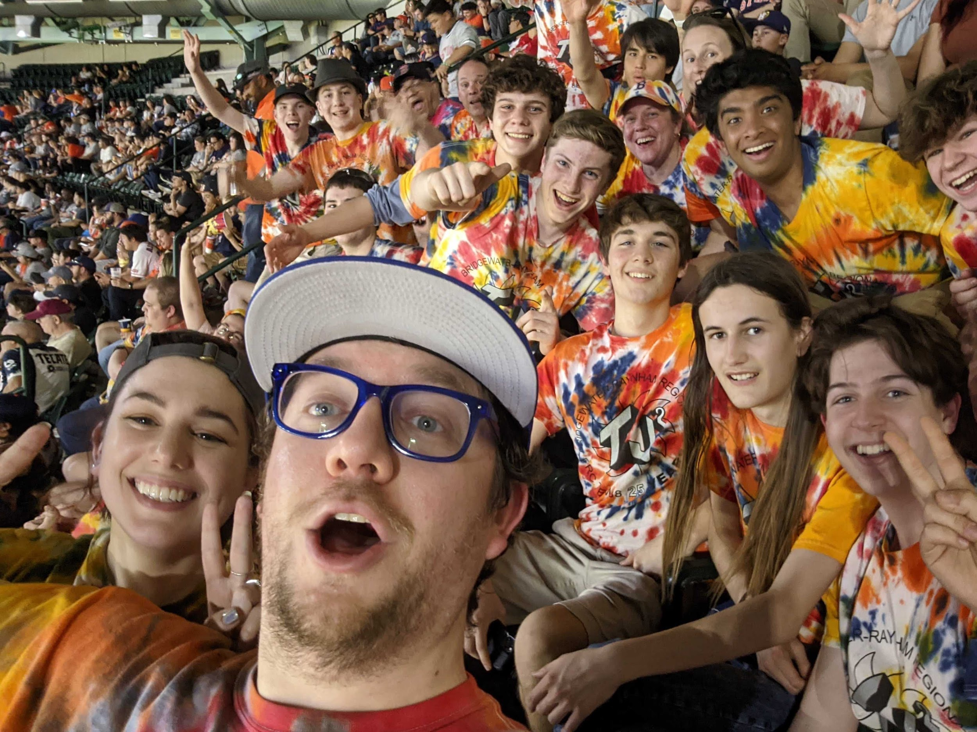
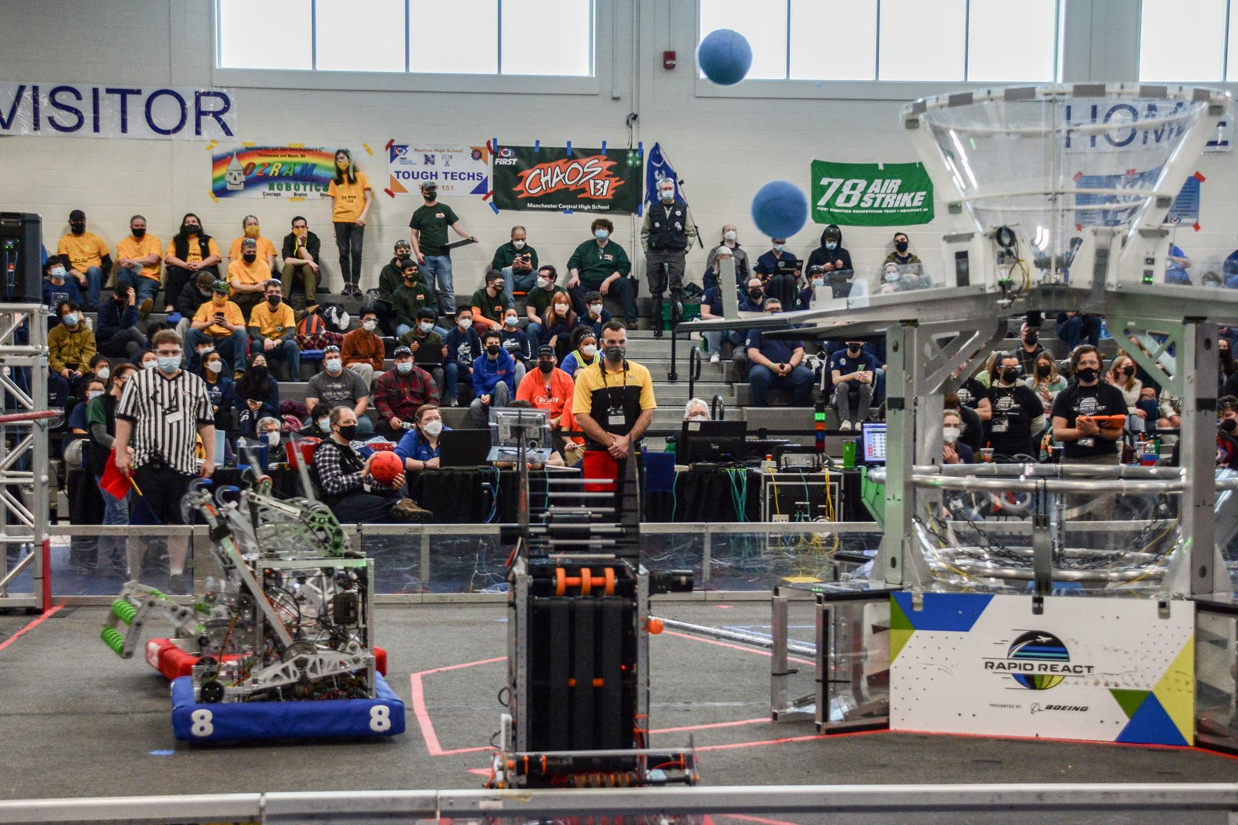
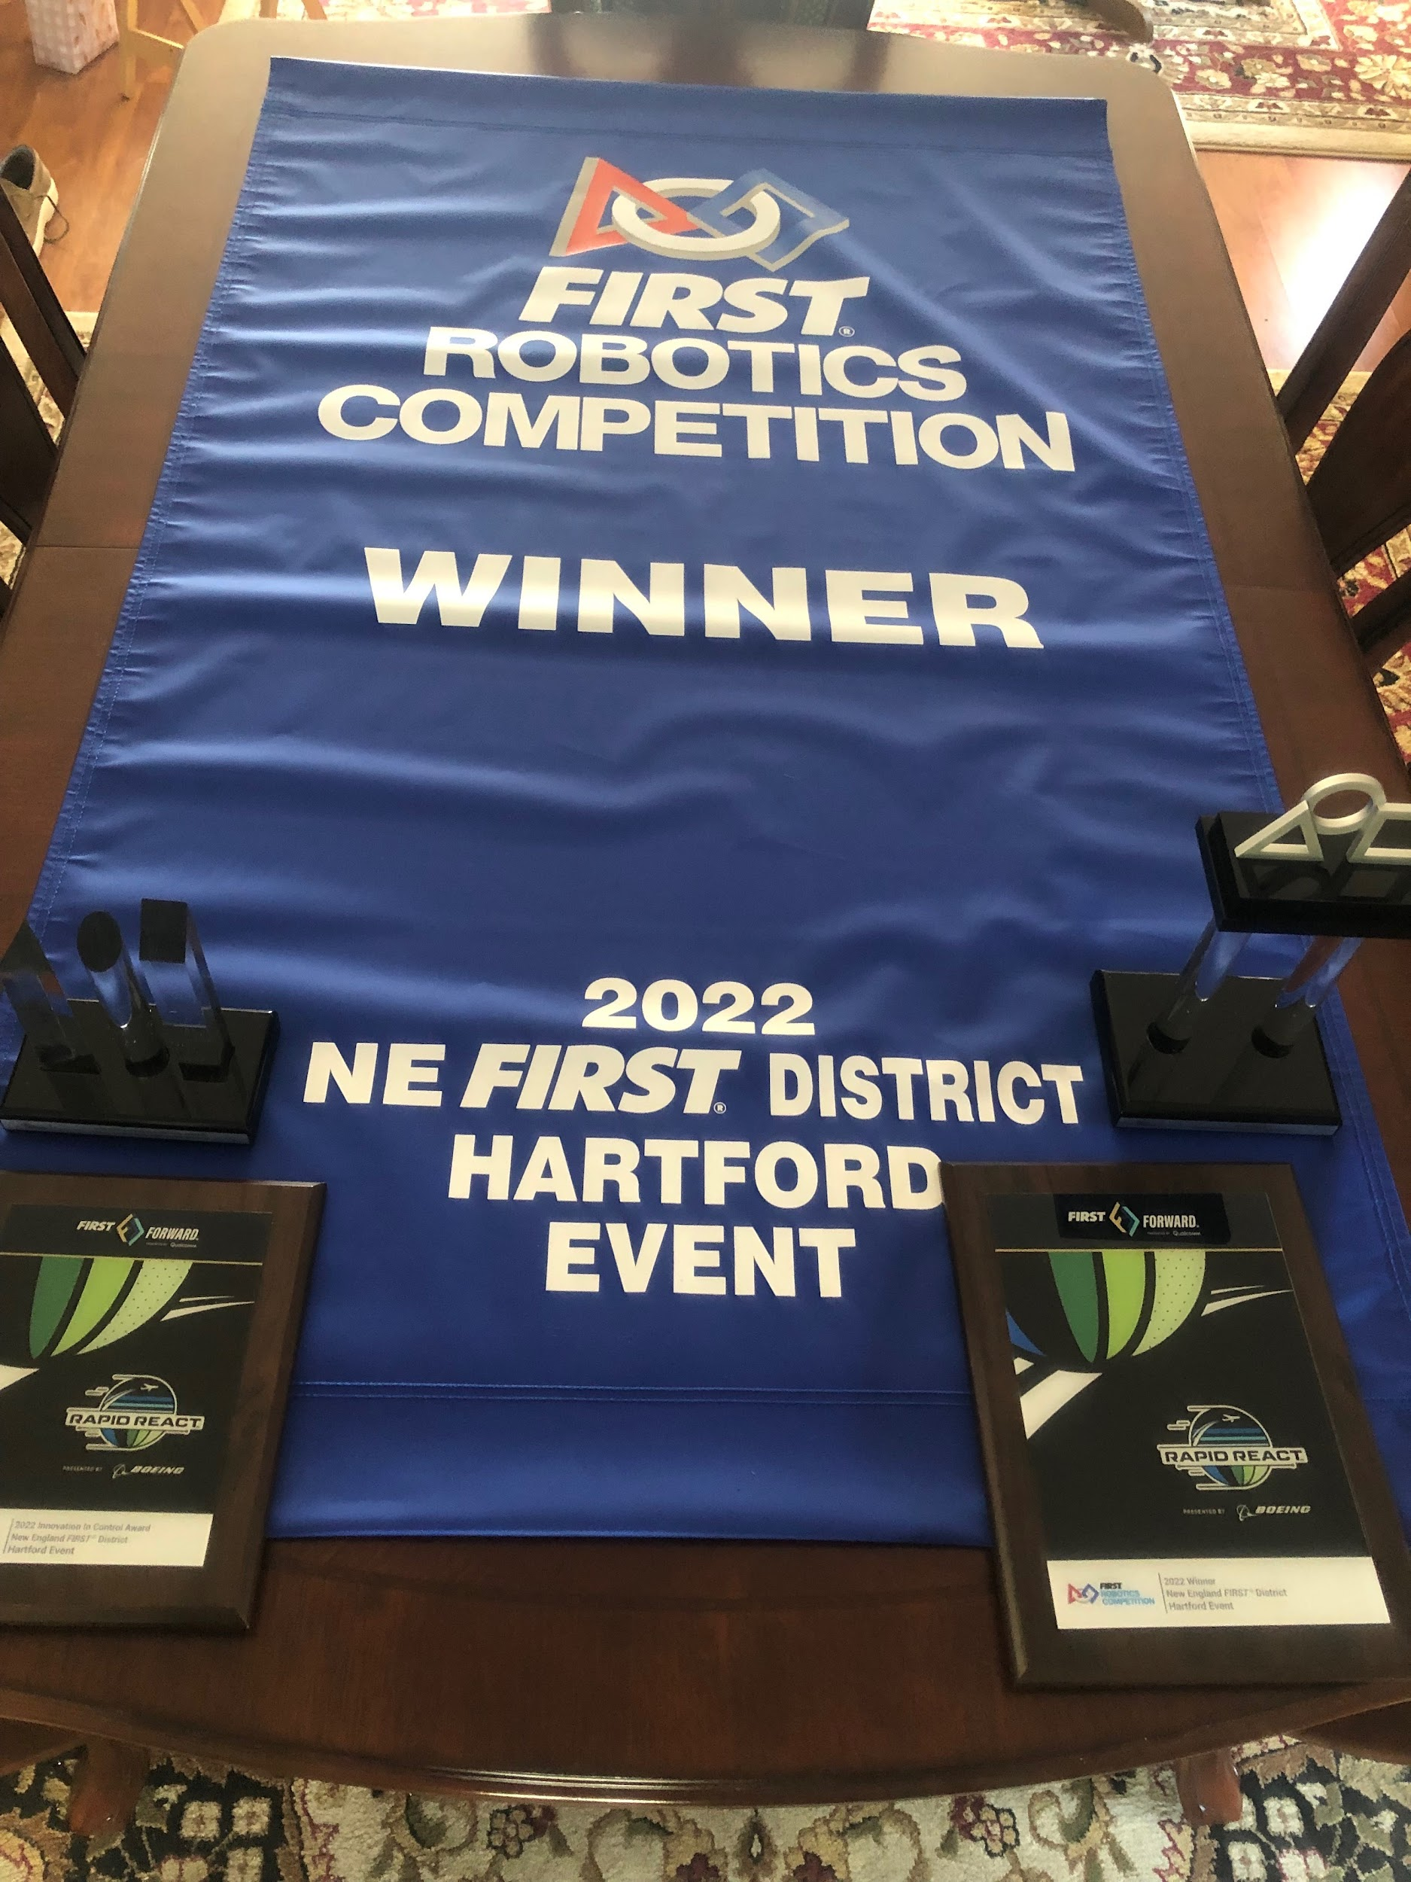
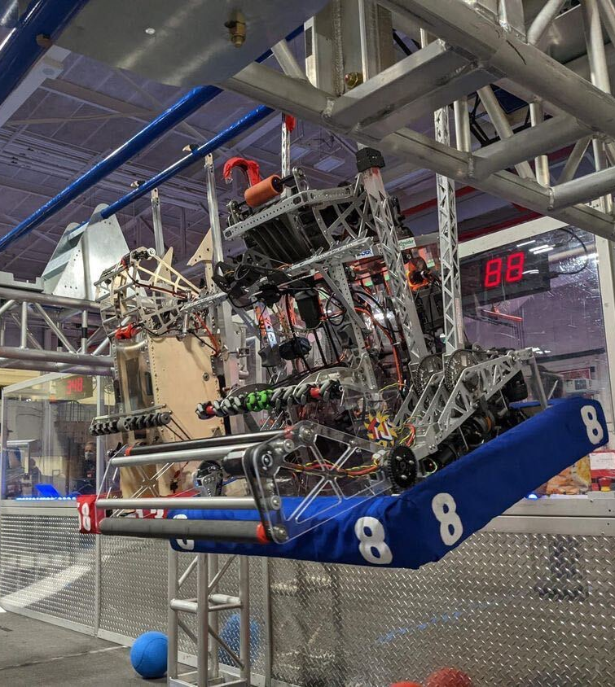
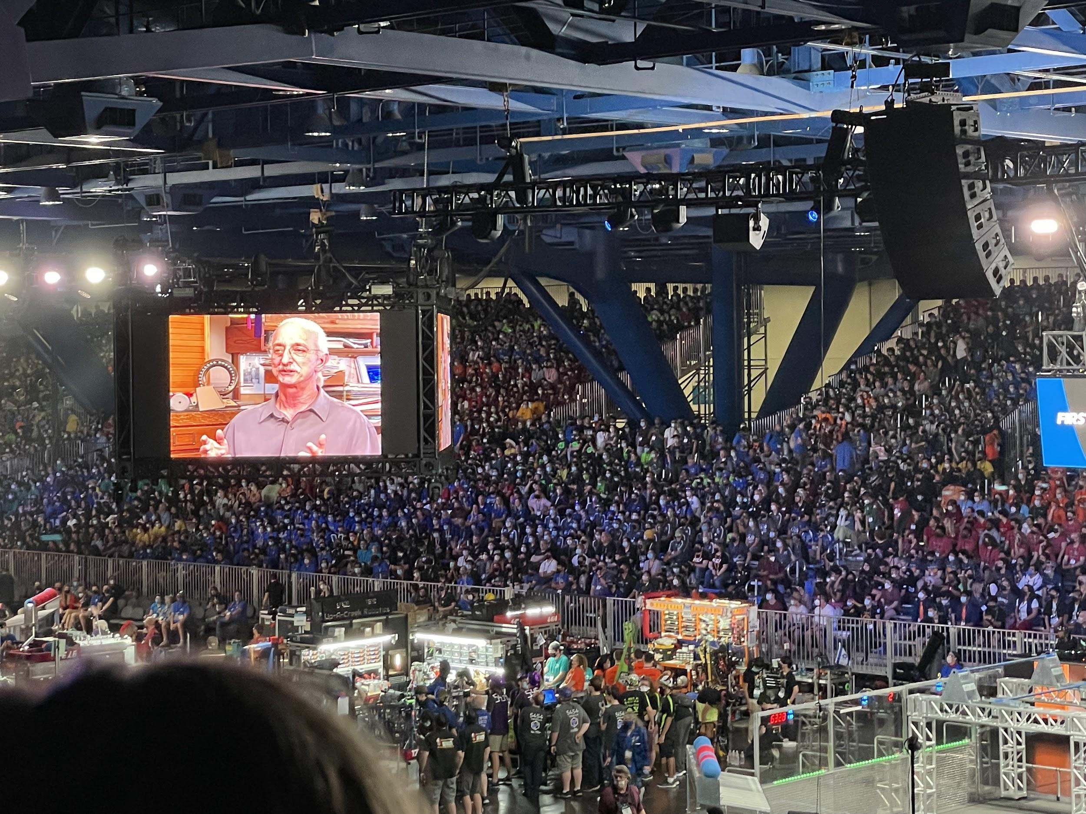
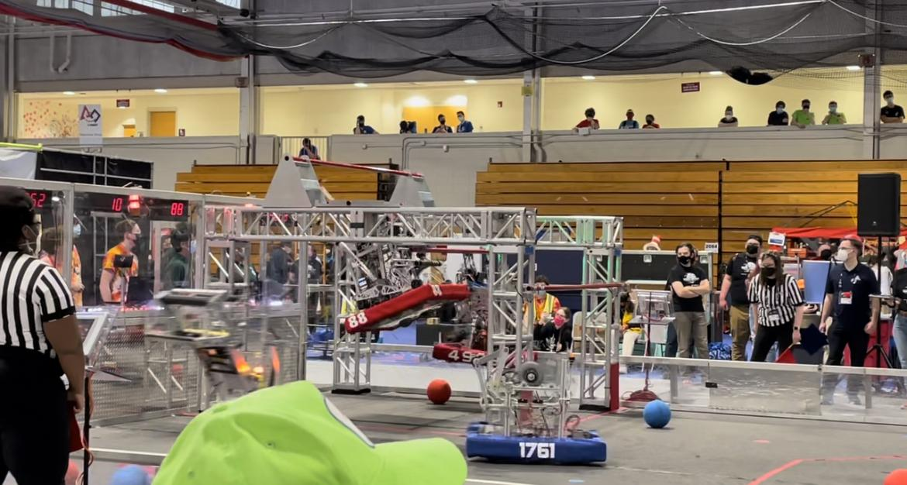
LATEST COMPETITIONS
Each year we go to many off season and seasonal competitions. These competitions help build our team rank during seasonal matches. Though we are a very competitive team, we are very proud of our team approach as we all join in and cheer our drive team and robot on!
Events of the 2022 FRC Season:
Granite State Competition
Manchester, NH
Hartford Competition
Hartford, CT
North Shore
Competition
Reading, MA
NE District Championship
Competition
Springfield, MA
World Championship
Competition
Houston, TX

Slide 6

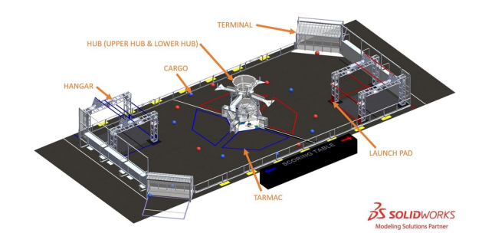
RAPID REACT
FIRST Headquarters designs a new game for us to play every year. The 2022 game was called Rapid React.
We will get the 2023 game at the FRC Kickoff on January 7, 2023.
To see the game animation click the video below:
Game Video

Slide 7
Communications
Google Classroom - Code 7nzsbss - all forms, requirements, messages, will be posted on the classroom-parents can be guests of their child
Team Calendar - www.tj2.org/calendar - we try to update this calendar with all meeting information.
Slack- after you are registered you will be invited to our Slack team communication app. Each group has a channel here to discuss and update all members.
  See Mr. or Mrs. Spurr at the end of this meeting for parent Slack
Email- we have asked you for an email address to provide updates and communicate with you. Please check your email regularly.
Phone- we collect your phone number to better communicate with you on trips. Please make sure you update us with any changes.
Team website - www.tj2.org - we try to keep this up to date with all of our activities.

Slide 8
FUNDRAISING
$400 to be a member of the team
$700 to be a member of the travel team
Due 1/7/2023
Events
Canal Day: October 2, 2022 Students will get sponsors for each mile they bike, rollerblade, etc. along the Cape Cod Canal. Also a great day to get to know students and mentors!
Dinner/Auction: Friday, December 2, 2022, Bridgewater Vets Club
Each student is required to turn in a minimum of one item to our auction that has a value of at least $25.
Students will be required to sell a minimum of two tickets to the dinner/auction to adults (21+)
Business sponsorships: students contact businesses on our community business list to ask for sponsorship of our team.

Slide 9









SPONSORS
Whenever we wear our uniforms, we are aware that we are representing our sponsors, our school, our community, and our families. We value every sponsor that we interact with and thank them for their generous donations.

Slide 10
ROBOT REVEAL!
Every season our team and many other teams like to show off their robot for the current season. Below is our 2021-2022 robot reveal video made during the Rapid React season.
Click the link below to watch:
Video Link!

Slide 11
TJ2 ROBOT 2022!
Here is Trident
Robot Demo

Slide 12
Now What?
Art - Mondays 2-4pm BRRHS Rm B204
CAD - Tuesday 7-9pm by zoom
Programming - Thursday 7-9pm F114 during build sessions.
Build Thursday 6-9pm, Saturday 8:30-5pm, and other times as needed (see calendar)
Strategy - September 29 5-6pm
Build Training - Fridays 2-4pm BRRHS D134
PR/Outreach - Fridays 2:45-3:45 pm BRRHS D134 or virtual as needed
Paperwork and Fundraising to Ms Jerome BRRHS Rm H103
When do we start………..look at the calendar- www.tj2.org/calendar

Slide 13
Before you leave....please...
Fill in your registration form on Google Classroom
Pass in your permission form
Take a copy of the Parent/Student information form and read it.
You need the the registration form and the permission form passed in before your can participate in team activities.
If you have more questions:
Student/Parent Information Meeting
H103 Wednesday 9/21 at 7pm

Slide 14
THANK YOU!!
We hope you got an overview of our team and found a place for yourself here. This is a great opportunity to grow, learn, network, and be part of a 28 year tradition at BRRHS!
OH YEAH!

